Slide 1
Chinese Document clustering
陸建綱 leo
Notes:
Good afternoon . everyone
My name is 陸建綱,you can call me leo
I am first grader master student
The topic of my presentation is Chinese document clustering

Slide 2
Outline
What’s about document clustering
Difficulties
Experiment
Result
Conclusion & Future Improve
Notes:
The structure of my presentation is like this
First I will talk about What is document clustering
Second, the difficulties of this
Third , show a simple experiment I have done
Then , show the result , conclusion and future improve

Slide 3
what’s about document clustering
Document Clustering is a method for finding structure within a collection of documents, so that similar documents can be grouped into categories.
Unsupervised grouping of text documents into meaningful groups, usually representing topics in the document collection
Notes:
So what’s about document clustering
Document Clustering is a method for finding structure within a collection of documents, so that similar documents can be grouped into categories.
This is an Unsupervised grouping of text documents into meaningful groups, usually representing topics in the document collection

Slide 4

If today you have thousands of or millions of documents
How can you quickly group the documents and be accurate in the absence of human?
You may encounter some difficulties
Notes:
So think about
If today you have thousands of or millions of documents
How can you quickly group the documents and be accurate in the absence of human?
Now
You may encounter some difficulties

Slide 5
Difficulties
Unstructured data
Document is composed by words
How to capture the semantic in the document
How to encode the document
Let computer can process them
Chinese word is different from English
Maybe two or three words concatenate together be the smallest semantic unit
Notes:
First ,document is Unstructured data, it is composed by words
How to capture the semantic in the document
And
How to encode the document ,so that computer can process them
Chinese word is different from English
Maybe two or three words concatenate together be the smallest semantic unit

Slide 6
Experiment
Raw data
6797 news text
Preprocessing
Get document vectors
word2vec
Reduce vector dimension
PCA
Clustering
K-Means
Visualize
Notes:
This is the process
Raw data I have is about 6 thousands newspaper text
I got it from my college teacher
Then do some Preprocessing
Use word2vec to get document vectors
Use PCA to Reduce vector dimension
Then use K-Means to do the clustering
Final show some visualization of documents
I will simply go through these algorithm I use

Slide 7
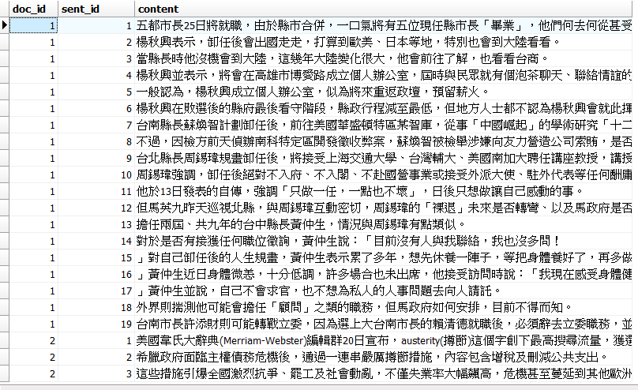
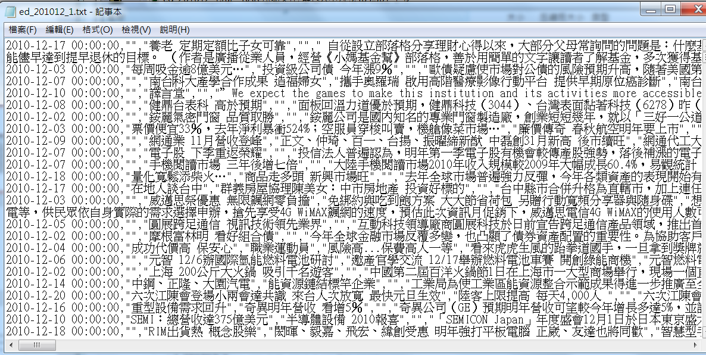
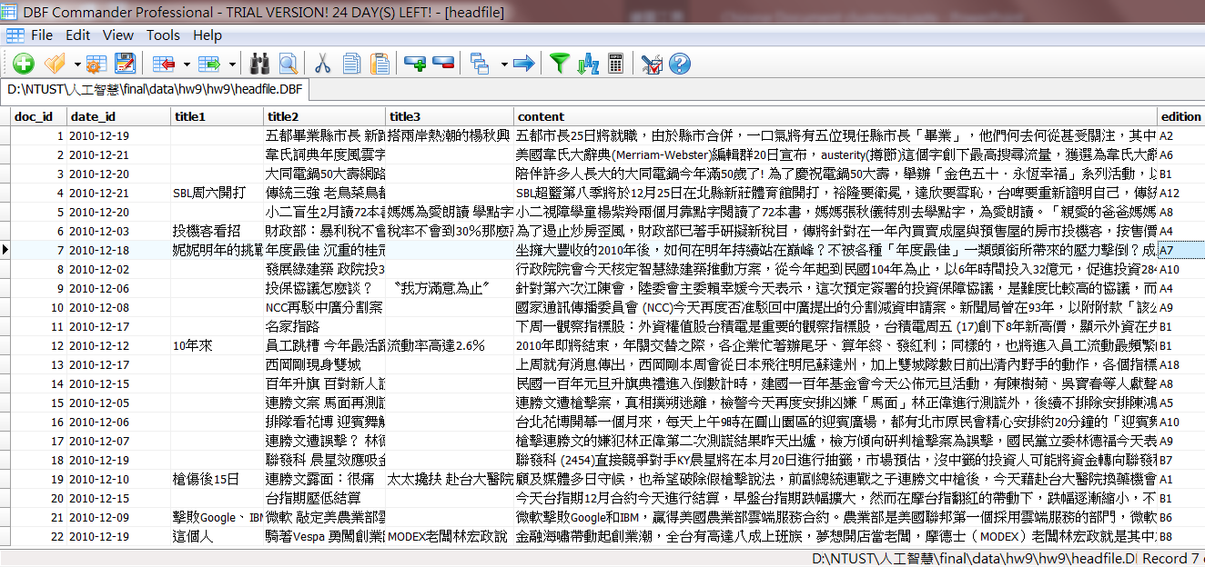
Raw data
6797 news text
美國韋氏大辭典(Merriam-Webster)編輯群20日宣布，austerity(撙節)這個字創下最高搜尋流量，獲選為韋氏大辭典2010年度風雲字詞。
美國韋氏大辭典編輯群日宣布，撙節這個字創下最高搜尋流量，獲選為韋氏大辭典年度風雲字詞。
Sentense segmentation(use jeibra)
Words concatenate together be
the smallest semantic unit in Chinese
Remove alpha and number in sentense
Split document into sentenses
Use Foxpro to split text and into databse
Only preserve doc_id and context (document)
America
throughput
美國韋氏大辭典編輯群日宣布，撙節這個字創下最高搜尋流量，獲選為韋氏大辭典年度風雲字詞。
美國 韋氏 大辭典 編輯 群日 宣布 撙節 這個 字 創下 最高 搜尋 流量 獲選為 韋氏 大辭典 年度 風雲字 詞
dictionary
Notes:
this is the raw date(click)
split text into database(click)
the column we need only the document id and the content(click*2) (click)
the two column can represent a document(click)
split document into sentences(click)
like this , every document is composed by a lot of sentences(click)
now, remove alpha and number in sentense ,only preserve chinese(click)
(picture)this is a sample (click), these word are removed (click)
now, do sentense segmentation , i use jeibra , why do this because in chinse ,maybe some words concatenate together be the smallest semantic unit(click)
(picture)-->click*3(this two wors represent america,this three words represent a large dictionary and this two words represent throughput) (click)

Slide 8
Word2vec
Skip-gram model
Using a word to predict a target context
Continuous bag of words(CBOW)
Using context to predict a target word
Notes:
I will use word2vec to capture the semantic of word level
The word2vec has to models ,
first is Skip-gram model, Using a word to predict a target context .
Second is Continuous bag of words(CBOW) , Using context to predict a target word
I use the first one to do this experiment

Slide 9
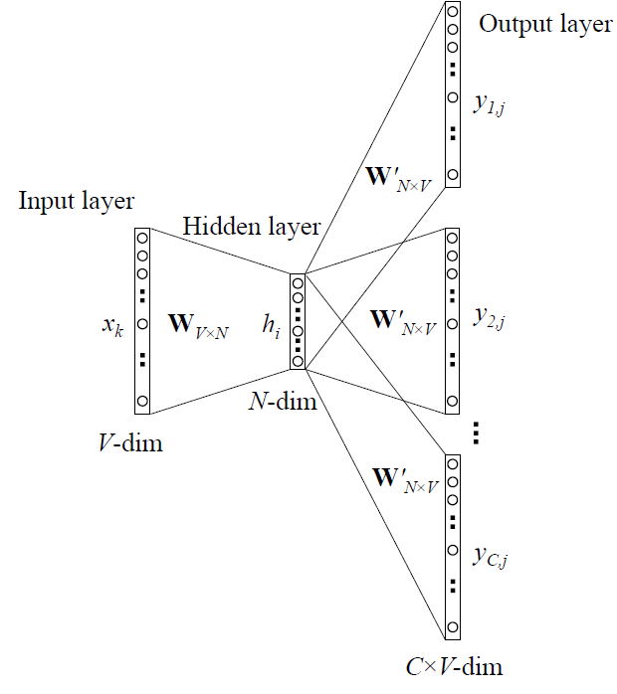
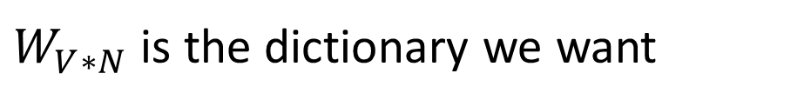
Word2vec
$W_{V∗N}$ is the dictionary we want
Used to capture word level semantic
Notes:
The method is a single hidden layer neural network
The Input is one-hot word vector.
The output is the corresponding word around the input word depend on the window size
The first trained parameter matrix is the dictionary we want(every word will get a vector to represent themselves)

Slide 10
Get word vector
Use genism word2vec (python 3.6)
250 dimension , window size=5
min_count=5, learning rate=0.025
Get a word dictionary
23,767 vector from 2,999,179 tokens
These vector preserve the semantic of word level
Notes:
I use genism’s word2vec
The dimension is 250,the window size is 5, min count is 5 and the learning rate is 0.025
Get a word dictionary , there are about twenty three thousands vectors from about 3 million tokens
These vectors preserve the semantic of word level

Slide 11
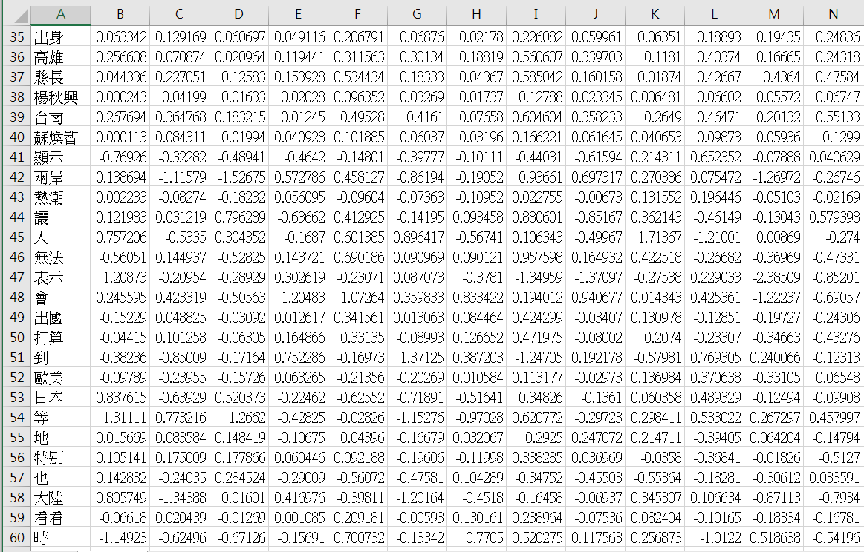
Get word vectoer
Notes:
Like this
Every word has their own vector
Dimension is 250

Slide 12
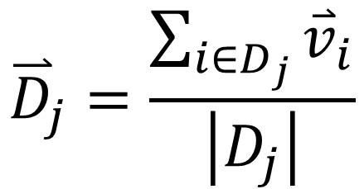



Get document vector
Intuitively, I get the document vector by mean of the word vector in the same document (this is a very simple way…)
$${\overset{⃑}{D}}_{j}=\frac{\sum_{i∈D_{j}}{{\overset{⃑}{v}}_{i}}}{\left|D_{j}\right|}$$
${\overset{⃑}{D}}_{j}$: vector of document j
$\left|D_{j}\right|$ : number of words in document j
${\overset{⃑}{v}}_{i}$: word i ‘s vector
Document vector’ dimension is 250
Notes:
How to get the document vectors
Intuitively, I use mean of the word vector in the same document (this is a very simple way…)
Like this formula

Slide 13
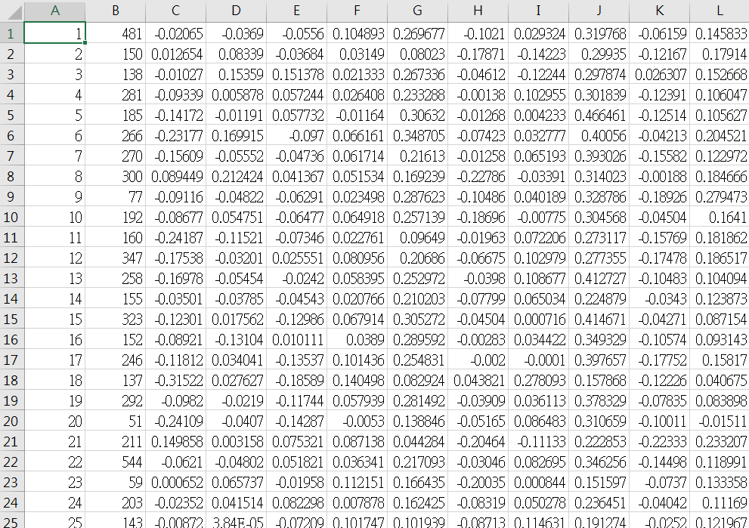
Get document vector
Notes:
And we can get vector for every document
The first column is the document id
The second is the number of words in one document
The remaining column is the vector
These are high dimension vector(click)

Slide 14
PCA
Principle Component Analysis
Used to reduce the dimension
Notes:
so I use PCA (Principle Component Analysis)
Used to reduce the dimension(click)

Slide 15
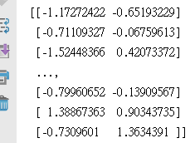
Document vector after PCA
Use scikit-learn PCA (python 3.6)
250 dimension→2 dimension
Notes:
I use sikit(賽kit)-learn’s PCA
Transform 250 dimension to 2 dimension (by select the first 2 principle component)

Slide 16
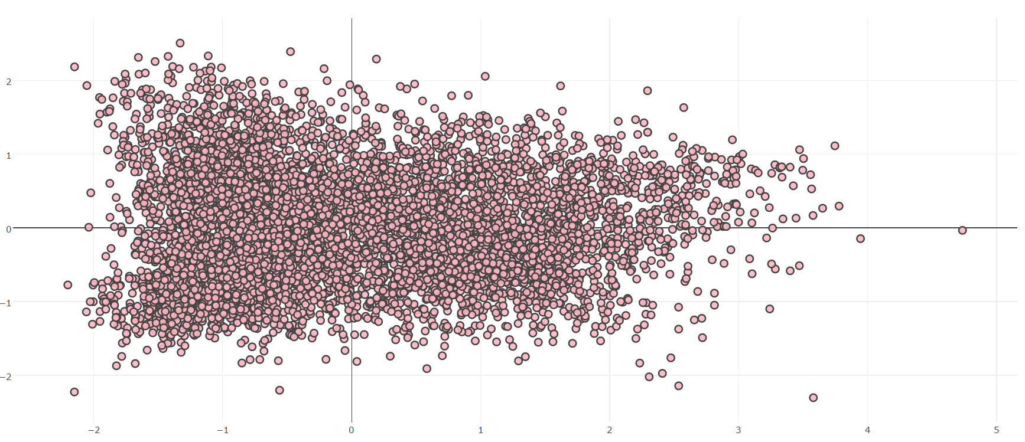
Document vitalization
Contains 6979 data points(use plotly )
Notes:
this picture contains 6979 data points(use plotly )
I use k-means to do the clustering

Slide 17
K-Means
Initial k clusters
Maximize the similarity between each cluster Minimize internal similarity
Use silhouette analysis to find which cluster number is better
Notes:
Initial k clusters
The purpose of k-means is to Maximize the similarity between each cluster , and Minimize internal similarity
The I use silhouette(sili-wet) analysis to find which cluster number is better

Slide 18
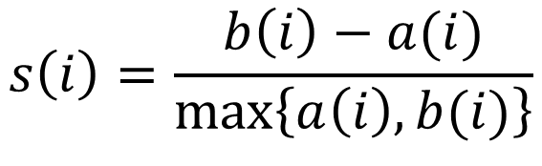
Silhouette analysis
a way to measure how close each point in a cluster is to the points in its neighboring clusters.
a neat way to find out the optimum value for k during k-means clustering
$$s\left(i\right)=\frac{b\left(i\right)−a(i)}{\max_{}\left\{a\left(i\right),b(i)\right\}}$$
Notes:
a way to measure how close each point in a cluster is to the points in its neighboring clusters.
This is a neat way to find out the optimum value for k during k-means clustering
a(i) is the mean distance of point i with all other data within the same cluster
b(i) is the mean distance of point(i) to other points which are in other clusters

Slide 19
Silhouette analysis
Silhouette coefficients near +1 indicate that the sample is far away from the neighboring clusters
A value of 0 indicates that the sample is on or very close to the decision boundary between two neighboring clusters
Negative values indicate that those samples might have been assigned to the wrong cluster
Notes:
If Silhouette coefficients near to positive 1 means the sample is far away from the neighboring clusters(this is good)
If the value is close to 0 means the sample is close to the decision boundary
If the value is Negative means maybe the sample is assigned to the wrong cluster

Slide 20
Silhouette analysis
Use Euclidean distance
Notes:
I use Euclidean(u klidean) distance
And choose the cluster number is 5 to do the k-means

Slide 21
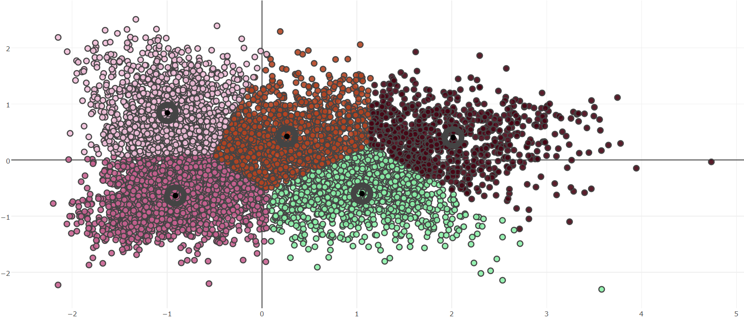
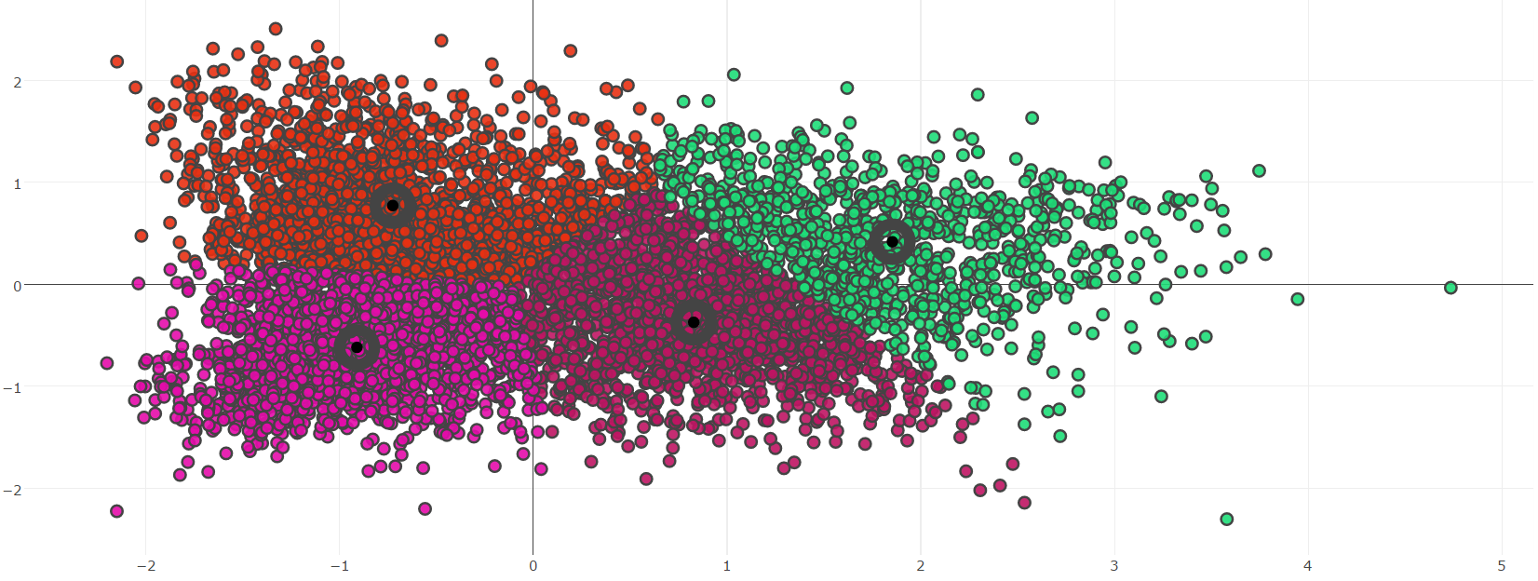
K-Means
2
中石化 化纖業報佳音
越峰 8121，建議股價85~90元
ＱＥ3敲開地產股金庫
風‧雨‧沙‧雪‧浪輪番重創中東
3
房市交易 上看40萬筆 3年新高
大樂透 31、42
二代健保 年獎、證交稅不列入
Adobe季報驚艷
Life
+
Economy
Industrial Economy
+
Disaster
Use Euclidean distance
4
利物浦作客求不敗
富邦全球投資等級債券基金 6日推出
士林官邸正房元月開放
電子書 元太續熱 一路旺到年底
Economy
+
Sports
1
跨縣市考生 將設專屬考場
越版仔仔獻聲 新移民瘋狂
股票次級交易遭調查
廣豐 地產開發獲利
0
蘇貞昌織夢重現音樂會
外資看封測雙雄錢景
電子襪判決 最快後天公布
蘇嘉全 今回鍋民進黨秘書長
Society
+
Economy
Political
+
Administration of justice
Notes:
this cluster number is 4 (click)
this cluster number is 5
we can see the 4 documents which is closest to the center of every cluster
i think the effect is not very good
0:政治、司法(political + administration of justice)
1:社會、經濟(society + economy)
2:產業經濟、天災(Industrial Economy +disaster)
3:生活、經濟(life + economy)
4:體育、經濟(economy + sports)

Slide 22
Conclusion & Future Improve
Use CKIP maybe better than jeibra
Not only use word semantic, maybe add more sentence semantic (CNN)
Add title vector and give different weight to context when create document vector
(maybe title can capture the main semantic of the document)
Maybe the original dataset is too intensive, so that it can not separate well

Slide 23
Thanks for your listening

